Slide 1
Efficient Data Flows with QGIS and PostGIS
From the Field to Web and Reports
Notes:
NINA institute
INVAFISH:
ongoing research project on invasive fish species financed by RCN
Freshwater fish

Slide 2
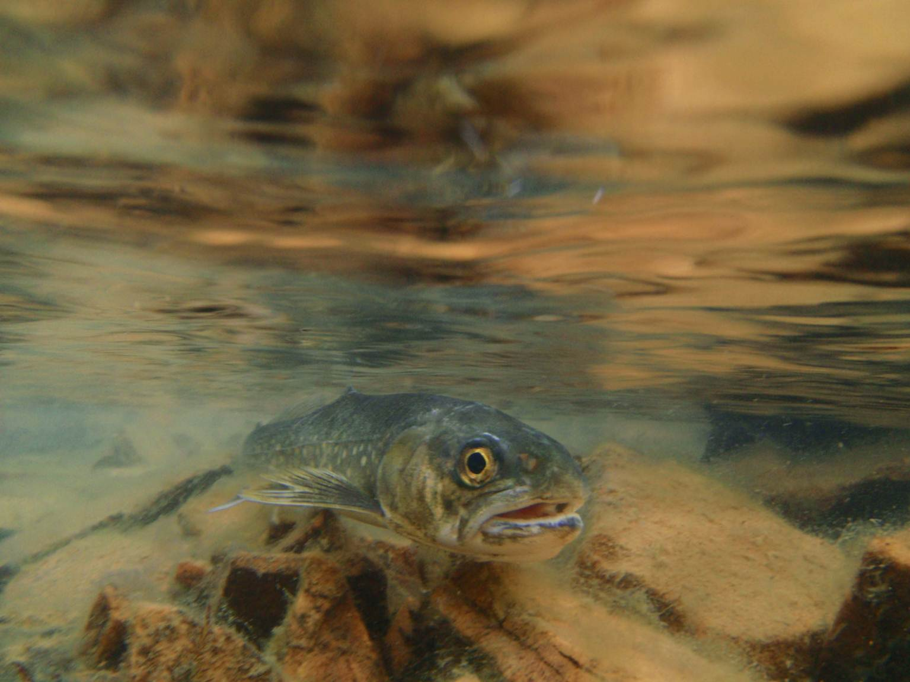
NOFA - Nordic Freshwater Atlas
Data infrastructure for freshwater species
Collection
Analysis
Preservation
Presentation
Publication
Long term
Workflow efficiency
Used in research projects (INVAFISH, …)
"Arctic char" by Anders Gravbrøt Finstad is licensed under CC BY-SA 2.0
https://www.flickr.com/photos/142379173@N08/28273400370/
Notes:
Central infrastructure
Easy sharing
Audience
Researchers
Public
Used for Projects
INVAFISH
Future projects …

Slide 3










NOFA – technical architecture
NOFA
PUBLISH
STORE
INPUT
Fish occurrences
Environmental factors
BASH
PROCESS
SHARE
Notes:
Everything Open Source
OSGeo hosts most projects
Supports Open Source Projects
Ensures Quality
OSGeo project vs. Incubation Project
OSGeo-live
INPUT
Web
Desktop
Mobile
Script
STORE
Postgres/PostGIS is central
Publish to Internet (everyone)
Share Data to researchers
For fish
But also other usecases

Slide 4
Data Storage

Slide 5

Darwin core
International standard for species occurrence data
Data structure
Defined terms
Controlled vocabulary
Metadata
LOCATION
EVENT
OCCURRENCE
location type
waterbody
county
municipality
elevation
geometry
…
location
remarks
recorded by
date
reliability
dataset
…
event
species
remarks
…
Notes:
NOFA uses Darwin Core
Can be shared through GBIF

Slide 6
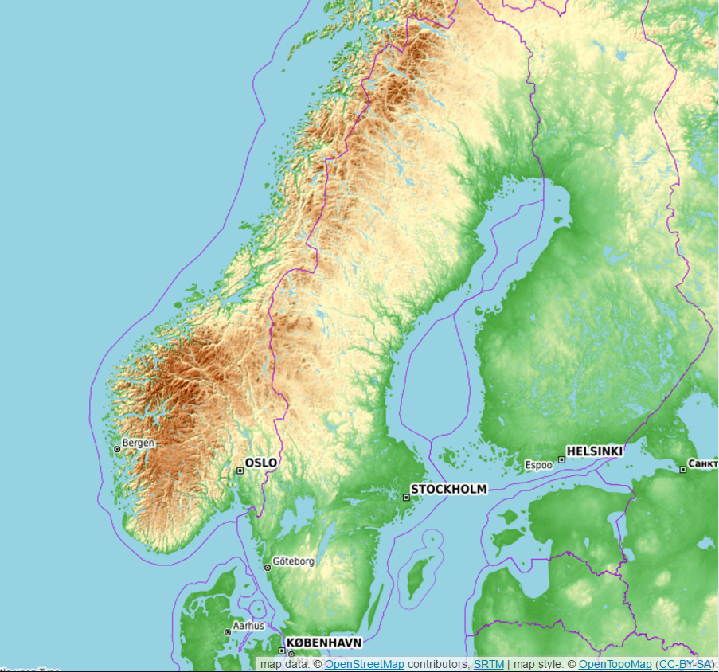
Additional Data
Lakes
~ 1.5 mio
Catchments
~ 270 000 largest lakes
Rivers
Streets
Land cover
Climate
Terrain model
Administrative units, …
map data: © OpenStreetMap contributors, SRTM | map style: © OpenTopoMap (CC-BY-SA)
Notes:
Lakes
~1.5 mio
Mapping Authorities
Individual lake catchments (~270k largest lakes)
Rivers (currently only Norway, NVE)
Streets (OpenStreetMap)
Land cover (Mapping Authorities)
Climate (EuroLST, FEM)
Terrain model (Mapping Authorities)
Administrative units

Slide 7
Display Data

Slide 8
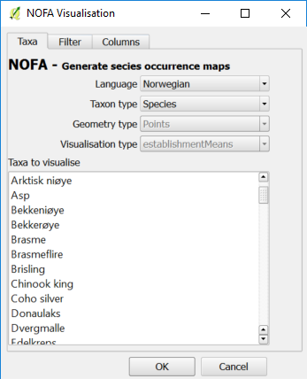
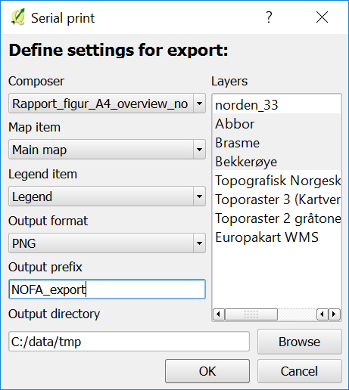
Visualisation and print plugins
Notes:
QGIS Plugins
Displaying custom data
Creates SQL in backgroung
Print
Merge with Input Plugin (?)

Slide 9

Publish Map - Lizmap
NOFA
Internet
Server
WMS
WFS
Notes:
Alternatives
Lizmap
Gisquick
QGIS Server
Map looks like in Desktop
Simple usage
Sharing with WMS/WFS

Slide 10
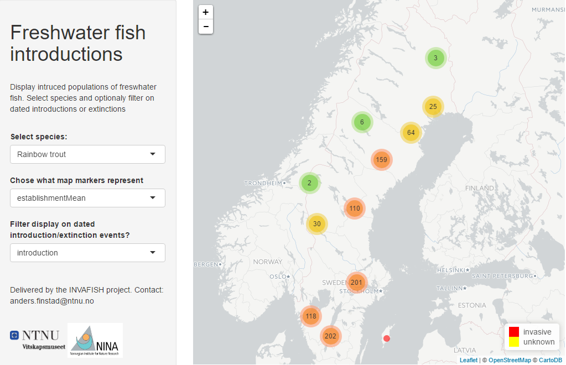
R Shiny
shiny.vm.ntnu.no/users/andersfi/invafish/
Notes:
Webapp with R
simple
Ideal for researchers

Slide 11
Insert and Edit Data

Slide 12
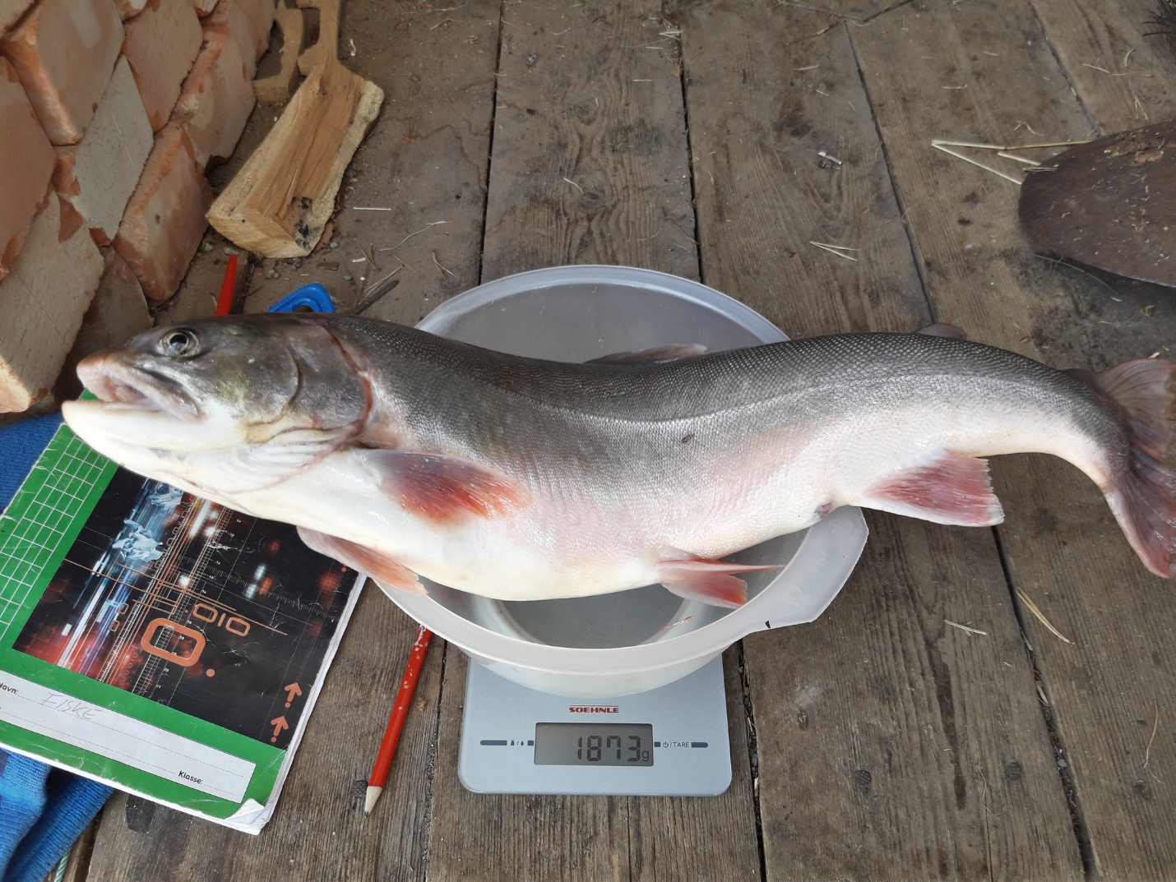
Field Data Collection
QField (Android)
QGIS (Windows Tablet)
IntraMaps Roam (Windows Tablet)
Lizmap (web browser)
OpenDataKit
GeoShape
…
"Arctic char" by Anders Gravbrøt Finstad is licensed under CC BY-SA 2.0
https://www.flickr.com/photos/142379173@N08/33790797954/
Notes:
Pen and Paper - classic approach
Qfield (Android)
QGIS (Windows Tablet)
IntraMaps Roam (Windows )
Based on QGIS
Lizmap – Webbrowser
OpenDataKit
Data collection suite
Client + Server
GeoShape
Data collection suite
Client + Server
Synchronisation
Internet
Later merge …

Slide 13
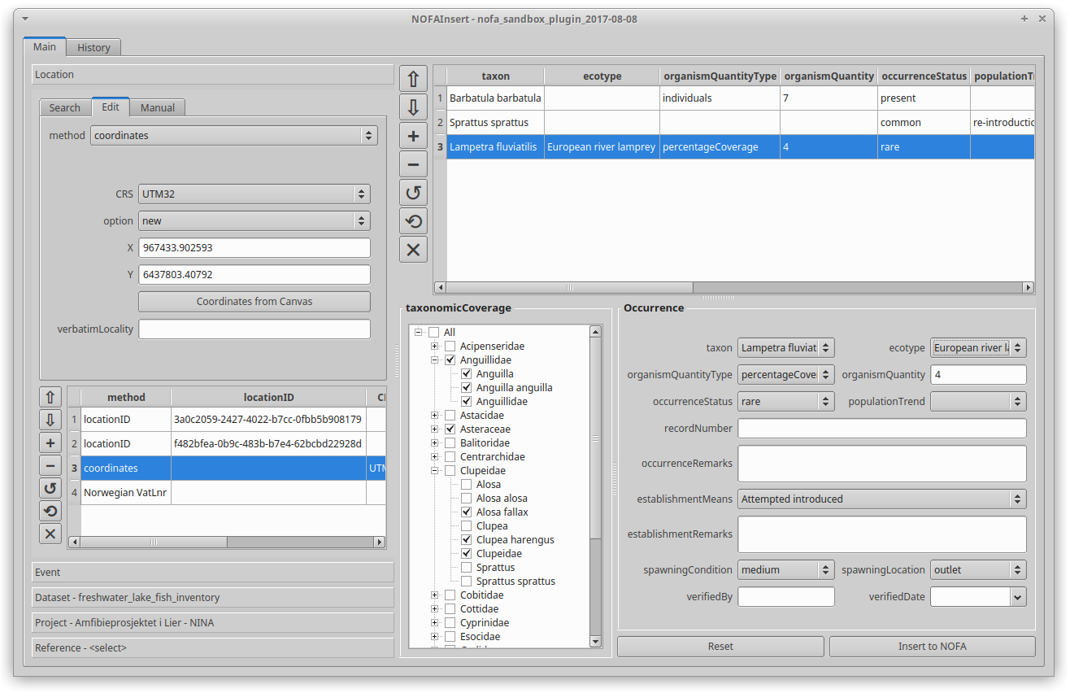
Desktop: QGIS Plugin
Motivation
QGIS – PostGIS layers
Scripts
Standard installation
Map canvas interaction
Not released yet
Notes:
QGIS in-built functions not enough

Slide 14
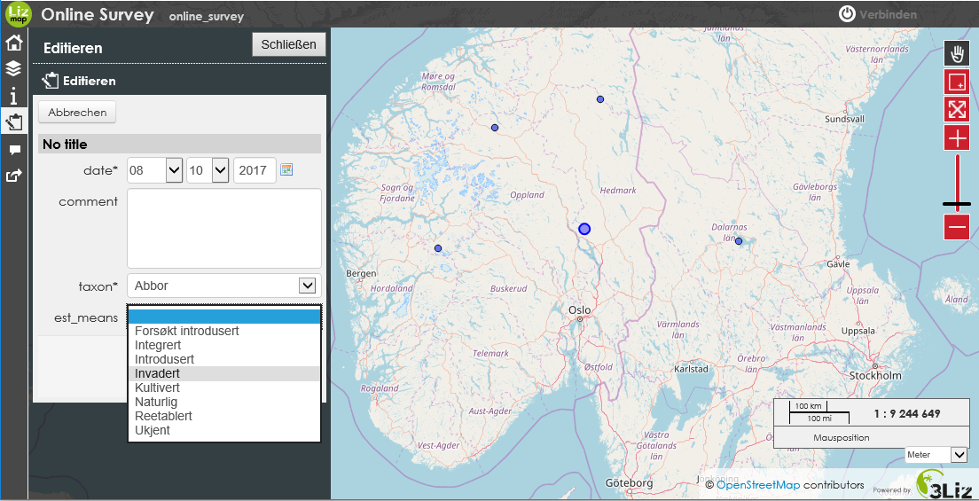
Web: Lizmap
tinyurl.com/Insertfish
Notes:
Insert Data via Browser
Support Relations
BUT did not work yet
Works on Mobile
Relativley simple to set up

Slide 15
Analyze Data

Slide 16

PostGIS processing
pgRouting
road
occurrence
occurrence
occurrence
occurrence
Notes:
PostgreSQL Functions
PL/pgSQL
Python
…
Location matching
Matches locations to lakes automatically
Trigger
Handles difficult cases
Distance to road
closest distance to any road
True polygon-line-distance
Wrapped in function
Closest Fish Population
closest fish population at a specific date
Output:
linear distance between lake
Future: river distance (?)
routing on river network
Rivers = streets
«river distance» between lakes
Finds all lakes upstream
Individual cost for each river segment (length, slope, … )
River distance matrix between lakes
TRIGGER
Quality assurrance
Location must be in Scandinavia
Automatically assign: county, elevation, climate, landcover …

Slide 17

R – Programming Language
Predefined functions
Process on the Server
Download Data “views”
By species
By event
…
Notes:
Process on server
Get custom data

Slide 18
Summary
NOFA
PUBLISH
STORE
INPUT
Fish occurrences
Environmental factors
BASH
PROCESS
SHARE
Notes:
Lots of Open Source packages for almost all needs
Interoperability as a big plus
Suitable for large amounts of data and demanding computations
QGIS loves PostGIS
Important step towards centralized data management
Cost effectiveness
Data quality
Data preservation
Data sharing

